Slide 1

CMR TECHNICAL CAMPUS(UCG AUTONOMOUS)
Kandlakoya, Medchal, Hyderabad – 501401
Department of Computer Science and Engineering
Predicting the Rice leaf diseases using CNN
Under esteemed guidance of
A.UDAY KIRAN
197R1A05F4- MAHEEN FATHIMA
197R1A05F9-PRARTHNA AGARWAL
197R1A05G5-SAMA SRAVANI

Slide 2
Abstract
Rice is one of the major cultivated crops in India which is affected by various diseases at various stages of its cultivation. It is very difficult for the farmers to manually identify these diseases accurately with their limited knowledge.
Recent developments in Deep Learning show that Automatic Image Recognition systems using Convolutional Neural Network (CNN) models can be very beneficial in such problems.
Since rice leaf disease image dataset is not easily available, we have created our own dataset which is small in size hence we have used Transfer Learning to develop our deep learning model.
The proposed CNN architecture is based on VGG-16 and is trained and tested on the dataset collected from rice fields and the internet.
.

Slide 3
Existing System
It is very difficult for the farmers to manually identify these diseases accurately with their limited knowledge.
developments in Deep Learning show that Automatic Image Recognition systems using Convolutional Neural Network (CNN) models can be very beneficial in such problems.

Slide 4
Disadvantages
It is attacked by a variety of diseases in various stages of its cultivation.

Slide 5
Proposed System
In this Project rice leaf disease image dataset is not easily available, we have created our own dataset which is small in size hence we have used Transfer Learning to develop our deep learning model.
The proposed CNN architecture is based on VGG-16 and is trained and tested on the dataset collected from rice fields and the internet.

Slide 6
Advantages:
To aid the plight of the farmers and provide improved accuracy of plant disease detection, research work using various machine learning algorithms using CNN

Slide 7
System Configuration:
SOFTWARE REQUIREMENTS
Operating System : Windows 10
Python ID : python 3.2.7,pycharm
HARDWARE REQUIREMENTS
RAM : 4GB and Higher
Processor : i3processor
Hard Disk : 500GB

Slide 8
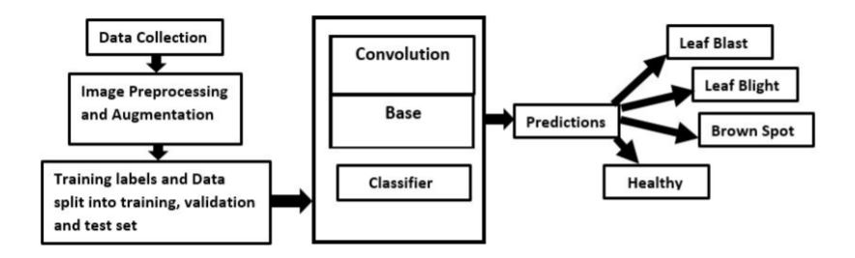
System Architecture

Slide 9
Modules:
Upload Image File
Image Preprocessing
TF learn with DL
Model Generation
Generate CNN & VGG16 Model
Predict For Image

Slide 10
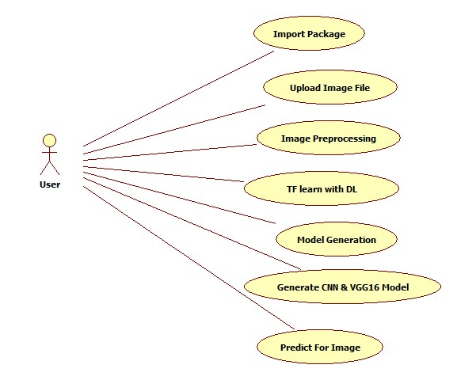
Use Case Diagram:

Slide 11
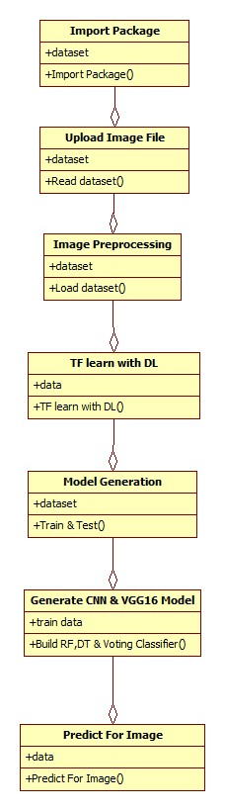
Class Diagram:

Slide 12
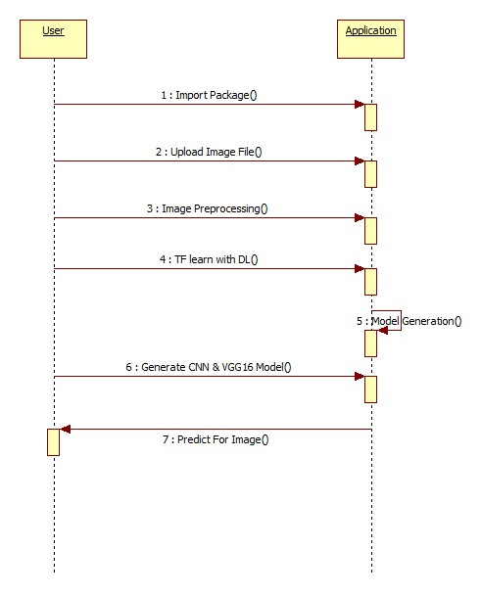
Sequence Diagram:
X
X

Slide 13
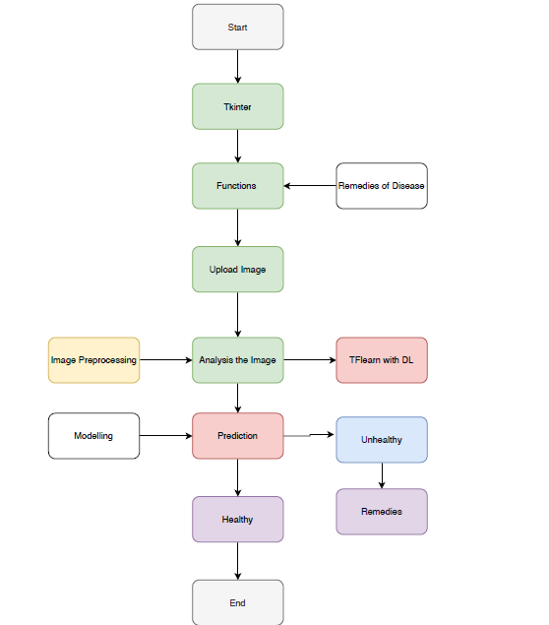
Activity Diagram:

Slide 14
Sample code:
from keras import applications
from keras.layers import Input
from keras.models import Model
from keras.layers import Conv2D
global load_model
global loaded_model
load_model = 0
global normal_accuracy
global vgg_accuracy
plants = ['Brownspot', 'Healthy', 'Leafblast', 'Leafblight']
from django.shortcuts import render
from django.template import RequestContext
from django.contrib import messages
import pymysql
from django.http import HttpResponse
from django.core.files.storage import FileSystemStorage
import os
from keras.models import model_from_json
import cv2
import keras
import numpy as np
import os
from keras.utils.np_utils import to_categorical
from keras.layers import MaxPooling2D
from keras.layers import Dense, Dropout, Activation, Flatten
from keras.layers import Convolution2D
from keras.models import Sequential
from keras.models import model_from_json
import pickle

Slide 15
def loadCNNModel():
global loaded_model
X_train = np.load('model/X.txt.npy')
Y_train = np.load('model/Y.txt.npy')
print(Y_train)
accuracy = 0
if os.path.exists('model/normal_model.json'):
with open('model/normal_model.json', "r") as json_file:
loaded_model_json = json_file.read()
classifier = model_from_json(loaded_model_json)
json_file.close()
classifier.load_weights("model/normal_weights.h5")
classifier._make_predict_function()
loaded_model = classifier
print(classifier.summary())
f = open('model/normal_history.pckl', 'rb')
data = pickle.load(f)
f.close()
acc = data['accuracy']
accuracy = acc[9] * 100
print("CNN without transfer learning Training Accuracy = "+str(accuracy))

Slide 16
else:
classifier = Sequential()
classifier.add(Convolution2D(32, 3, 3, input_shape = (64, 64, 3), activation = 'relu'))
classifier.add(MaxPooling2D(pool_size = (2, 2)))
classifier.add(Convolution2D(32, 3, 3, activation = 'relu'))
classifier.add(MaxPooling2D(pool_size = (2, 2)))
classifier.add(Flatten())
classifier.add(Dense(output_dim = 256, activation = 'relu'))
classifier.add(Dense(output_dim = 4, activation = 'softmax'))
print(classifier.summary())
classifier.compile(optimizer = 'adam', loss = 'categorical_crossentropy', metrics = ['accuracy'])
hist = classifier.fit(X_train, Y_train, batch_size=16, epochs=10, shuffle=True, verbose=2)
classifier.save_weights('model/normal_weights.h5')
loaded_model = classifier
model_json = classifier.to_json()
with open("model/normal_model.json", "w") as json_file:
json_file.write(model_json)
json_file.close()
f = open('model/normal_history.pckl', 'wb')
pickle.dump(hist.history, f)
f.close()
f = open('model/normal_history.pckl', 'rb')
data = pickle.load(f)
f.close()
acc = data['accuracy']
accuracy = acc[9] * 100
print("CNN without transfer learning Training Accuracy = "+str(accuracy))
return accuracy

Slide 17
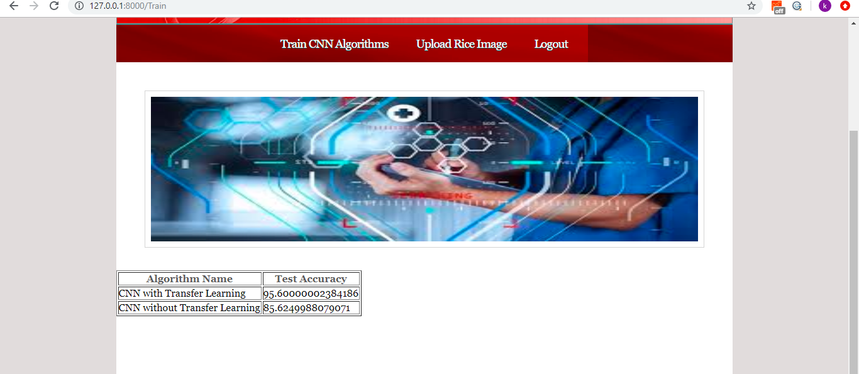
Screenshots:

Slide 18


Slide 19
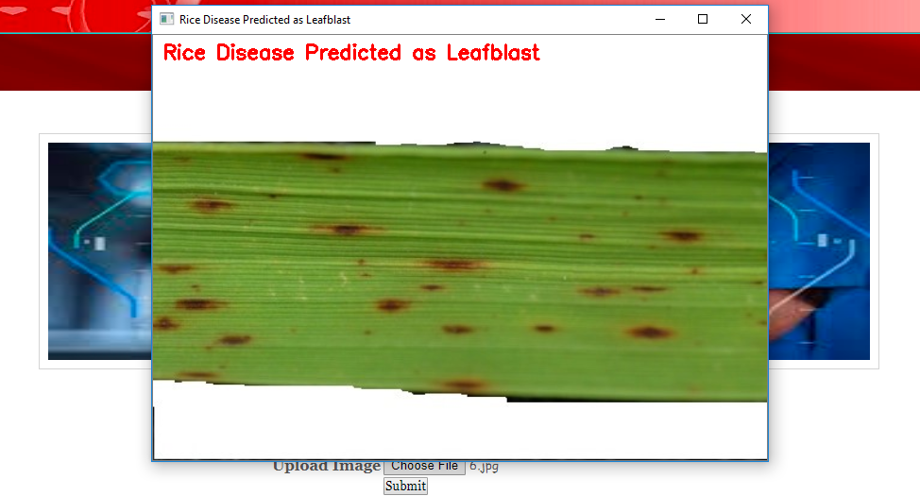

Slide 20
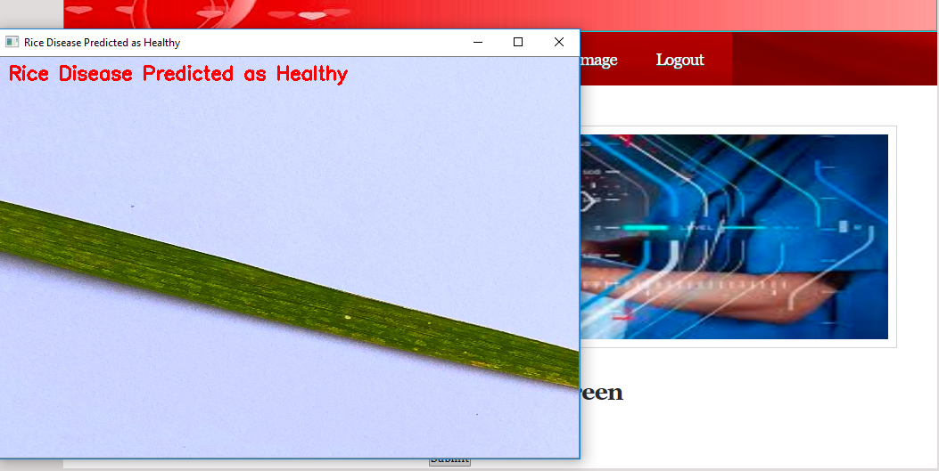

Slide 21
8.CONCLUSION
In this paper we have proposed a deep learning architecture with training on 2000 images of rice leaves and testing on different 700 images and that correctly classifies 92.46% of the test images. Transfer Learning using fine-tuning the predefined VGGNet has greatly improved the performance of the model which otherwise did not produce satisfactory results on such small dataset. The number of epochs used was stopped at 25 because we had received a cut point after which the accuracy was not improving and the loss was not decreasing on both training and validation data.

Slide 22
FUTURE ENHANCEMENT In future work, we would like to collect more images from agricultural fields and Agricultural Research institutes so that we can improve the accuracy further. We would like to add cross-validation process in future in order to validate our results. We would also like to use better deep learning models and other state-of the art works and compare it with the results obtained. The developed model can be used in future to detect other plant leaf diseases, which are important crops in India.

Slide 23
REFERENCES:
[1] T. Gupta, ”Plant leaf disease analysis using image processing technique with modified SVM-CS classifier,” Int. J. Eng. Manag. Technol, no. 5, pp. 11-17, 2017.
[2] Y. Es-saady,T. El Massi,M. El Yassa,D. Mammass, and A. Benazoun, ”Automatic recognition of plant leaves diseases based on serial combination of two SVM classifiers,” International Conference on Electrical and Information Technologies (ICEIT) pp. 561-566, 2016.
[3] P. B. Padol and A. A. Yadav, “SVM classifier based grape leaf disease detection,” Conference on Advances in Signal Processing (CASP), pp. 175-179, 2016.
[4] L. Liu and G. Zhou, “Extraction of the rice leaf disease image based on BP neural network,” International Conference on Computational Intelligence and Software Engineering ,pp. 1-3,2009.
[5] S. Arivazhagan and S.V. Ligi, “Mango Leaf Diseases Identification Using Convolutional Neural Network,” International Journal of Pure and Applied Mathematics, vol. 120,no. 6, pp. 11067-11079,2008.
Websites:
https://www.w3schools.com/python/
https://www.tutorialspoint.com/python/index.htm
https://www.javatpoint.com/python-tutorial
https://www.learnpython.org/
https://www.pythontutorial.net/

Slide 24
Thank You

